Slide 1


SMART STREET LIGHT
MANAGEMENT
USING IBM WATSON
TEAM PHOENIX

Slide 2
Problem statement-
Manual and Automatic switching off and on of street lights
considering the intensity of sunlight, brightness control of light on detecting movement using LDR , Ultrasonic sensor, NodeRed and MIT app inventor.

Slide 3
Our approach-
Two modes-
Automatic
Manual
Automatic :
Street lights are OFF during the day
Street lights are ON during the night with low intensity until a vehicle approaches. Then intensity increases.
Manual:
Using buttons from an android app to control the switches.

Slide 4
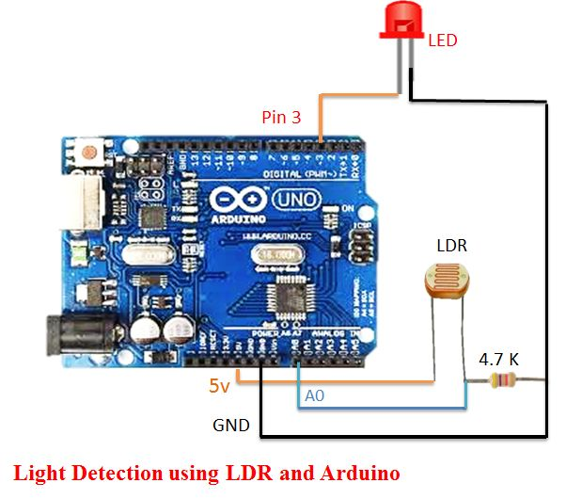
mechanism
ARDUINO IDE
NODE MCU
LDR
LED
ULTRASONIC SENSOR
Using NodeRed and MIT app inventor to create an app that controls the on and off of street lights. When LDR value > 700 and distance of the object detected by ultrasonic sensor < 100 , led glows with more intensity.

Slide 5
WHY DO WE NEED SMART STREET LIGHTS?
Less energy consumption
Improves light quality
Reduce maintenance
Reduce CO2 emission
Secure and safe

Slide 6
Thank you ☺
BY :
K. ALEKHYA
V. HRISHITHA
CH. MAHITHA

